Slide 1
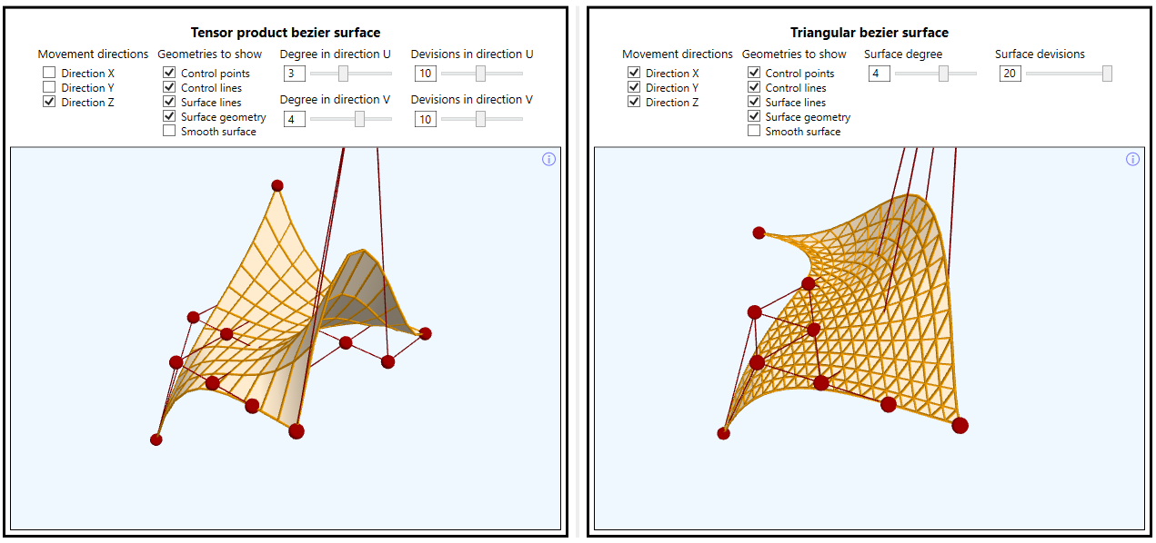

From XAML to cross-platform development with Unity
by Deyan Yosifov
Senior Software Developer @ Progress Telerik

Slide 2
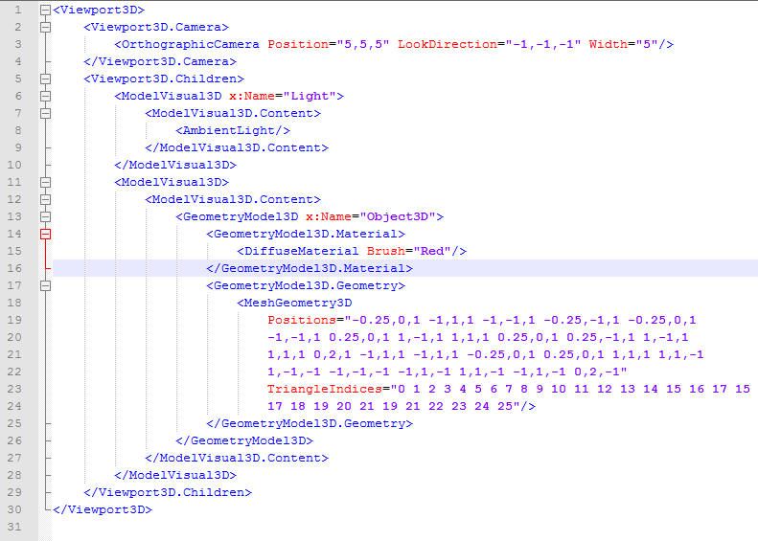
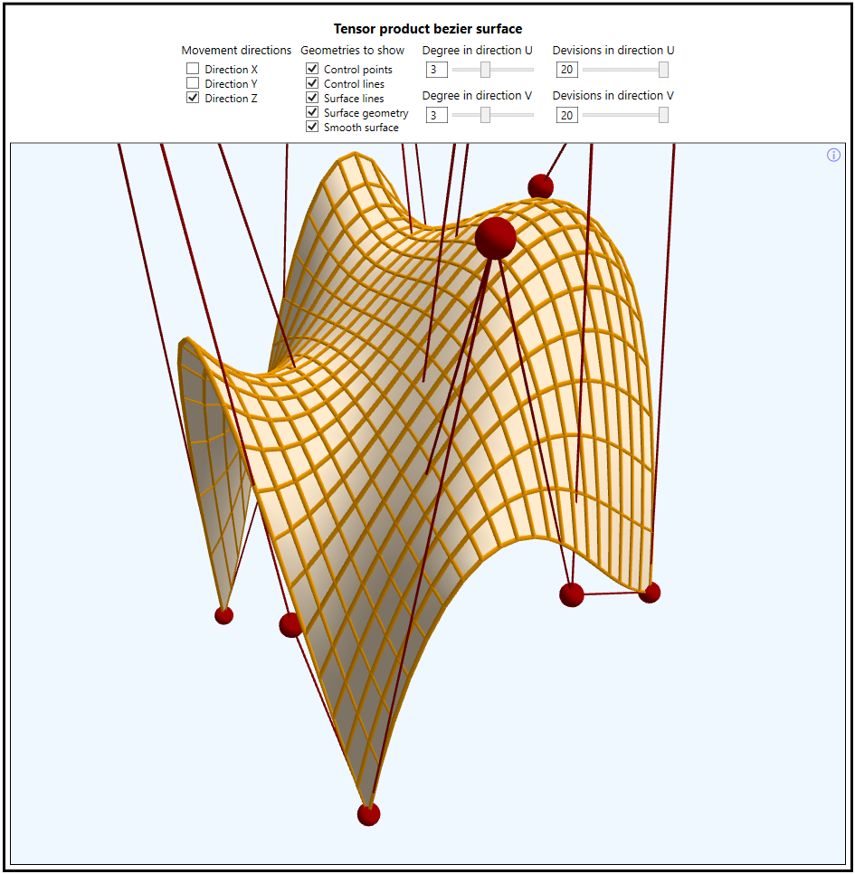
What is WPF 3D?
Built-in WPF functionality allowing to visualize 3D scene.
Easy way to integrate 2D UIElements with 3D Viewport.
3D API follows familiar WPF patterns and conventions which makes it easy to use.
3D scene may be defined either with XAML or with procedural code.

Slide 3
Scene graph hierarchy in WPF
Viewport3D is the parent element
Viewport3D.Camera property
Viewport3D.Children property
Visual3D elements – define 3D objects with Model3D and position them with Transform3D
Model3D elements – define the 3D objects look with Geometry3D and Material
Geometry3D elements – define the geometry points, triangles, light normals and texture coordinates

Slide 4
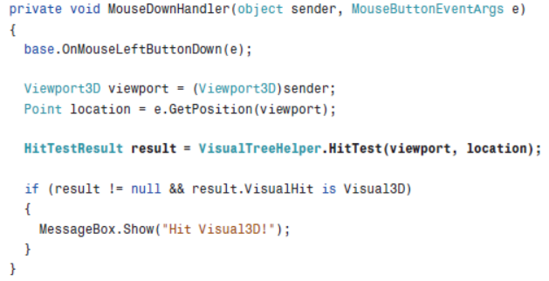
Interaction with 3D elements in WPF
Viewport3D
Attach to Mouse events of Viewport3D class.
Use HitTestResult to see if some Visual3D instance is interacted.
UIElement3D – attach to mouse events directly to a single 3D object in the scene.
Viewport2DVisual3D
Allows you to place 2D UIElement instances on the side of a 3D object.
Interact directly with the 2D UIElement instances using their mouse events

Slide 5
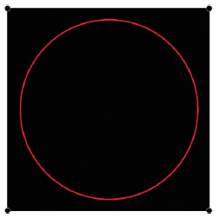
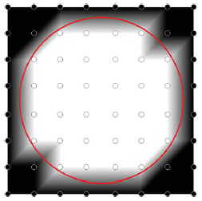
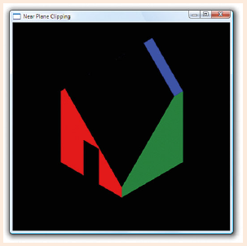
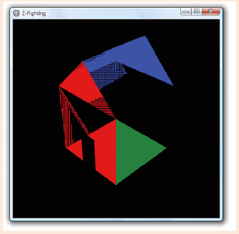
WPF 3D engine limitations
SpotLight and PointLight
May not shade light some triangles.
May be workarounded in some scenarios by making more dense mesh.
Transparency
The engine may not show some objects behind transparent triangles.
May be workarounded in some scenarios by reordering the children of the scene.
Translucent objects should be last scene’s children to ensure that WPF engine will render them last.
ProjectionCamera NearPlaneDistance and FarPlaneDistance properties may clip objects.
Z-fighting
When surfaces are close to each other the camera cannot determine which to show.
May be workarounded by changing the FarPlaneDistance not to be Infinity.
Does not occur when surfaces coincide exactly – the second rendered will appear on top.

Slide 6
WPF 3D performance tips
Viewport3D.IsHitTestVisible
Better be set to ‘false’ because otherwise every MouseMove makes hit tests with the whole scene.
Possible solution is to place Canvas over the Viewport3D and attach to Canvas Mouse events.
Still VisualTreeHelper.HitTest method may be used over Viewport3D when HitTestResult is needed.
Freezable objects
Call Freeze method if they are not going to be changed.
Consider using this approach for Brush, Material and Geometry3D classes.
Reuse whatever is repeating in the scene
Geometry3D (cylinders, cubes, spheres, ellipsoids, …)
Materials
GeometryModel3D
Use only front materials on objects that are not intended to be seen from inside.
Use simple materials when possible as material groups calculate the light on several passes.
More tips may be found in this MSDN performance article.

Slide 7
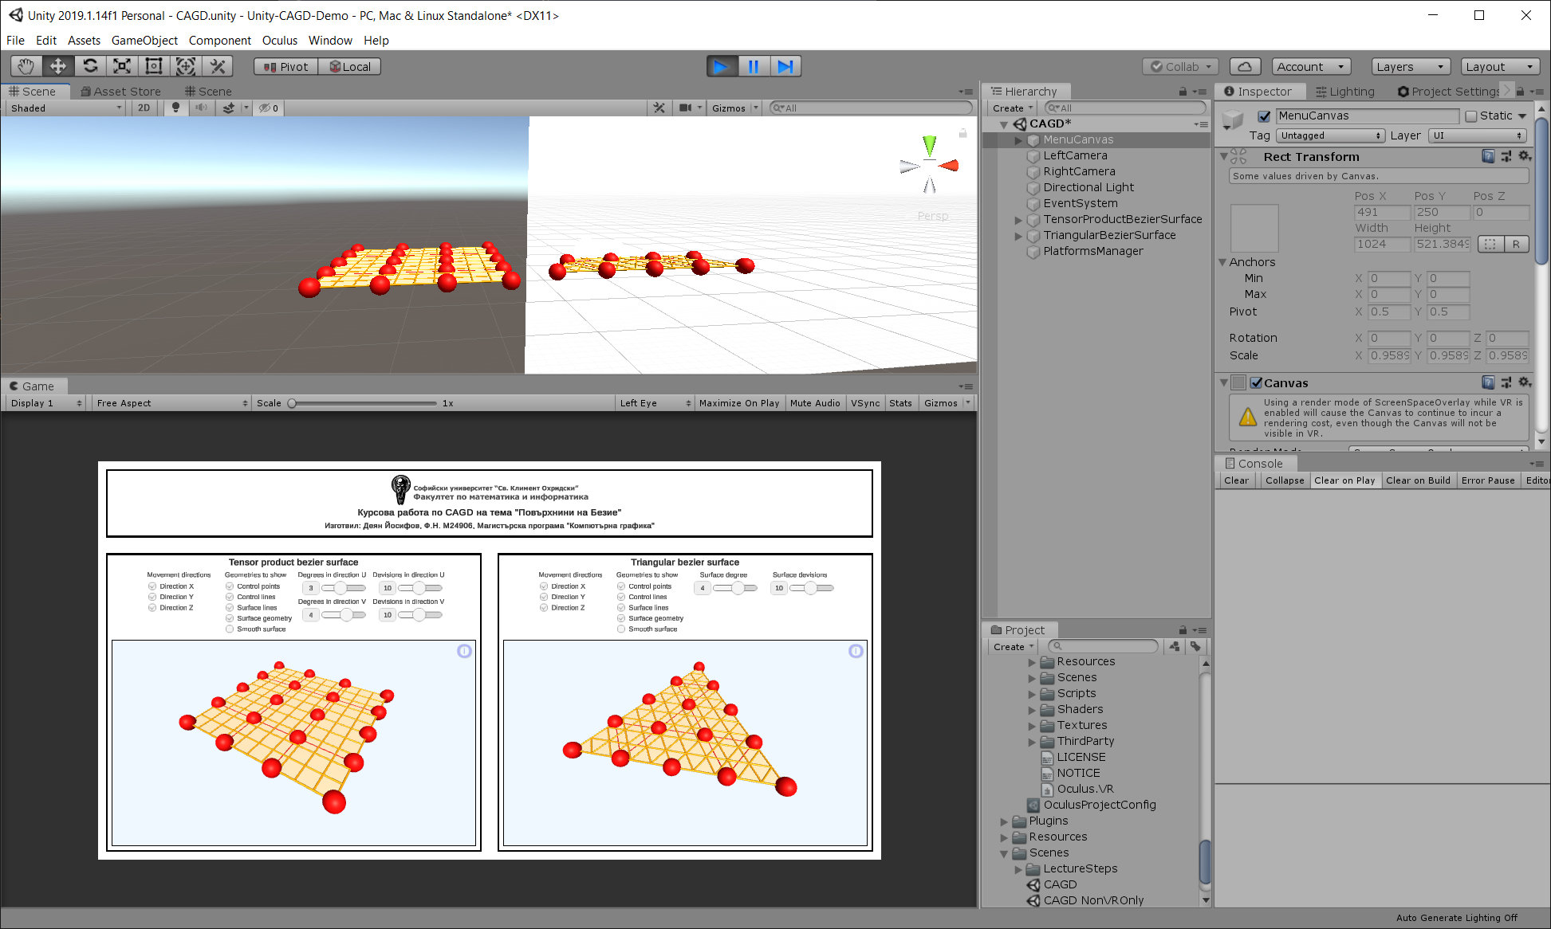
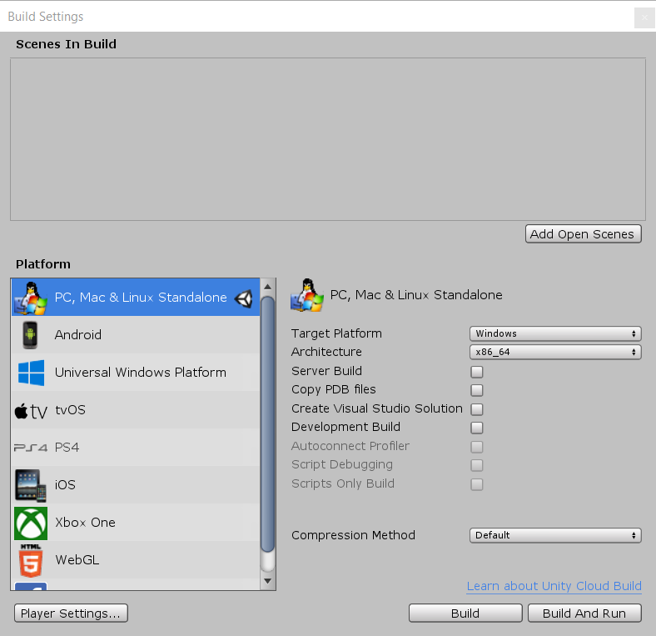
Unity – designed for building cross platform 3D apps

Slide 8
Unity vs WPF comparison
Unity provides larger variety of options when it comes to defining 3D content – materials, shaders, camera postprocessing, etc.
Unity uses composition pattern compared to the class inheritance which is typical for WPF.
Unity provides flexible way to reuse and in the same time modify scene content through its prefabs and prefab variants functionalities.
WPF is much more powerful when it comes to layouting 2D UI.
Unity provides more optimized approach for handling and interacting with the 3D elements by separating the collision components from the mesh components.

Slide 9
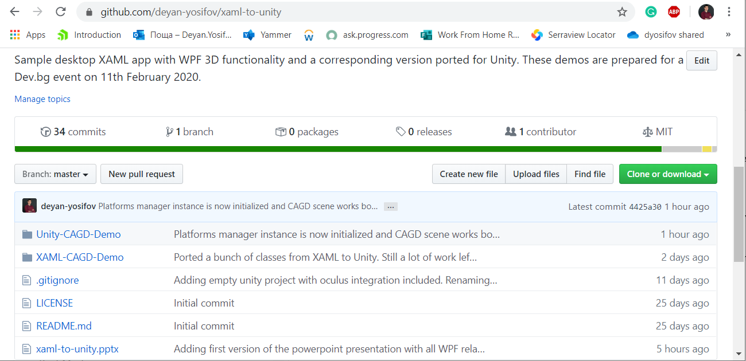
Our mission today
Go to https://github.com/deyan-yosifov/xaml-to-unity
See the WPF demo in XAML-CAGD-Demo folder.
See how it can be converted to Unity in Unity-CAGD-Demo folder.
Test our Unity demo for Web, Mobile, Desktop and VR.

Slide 10
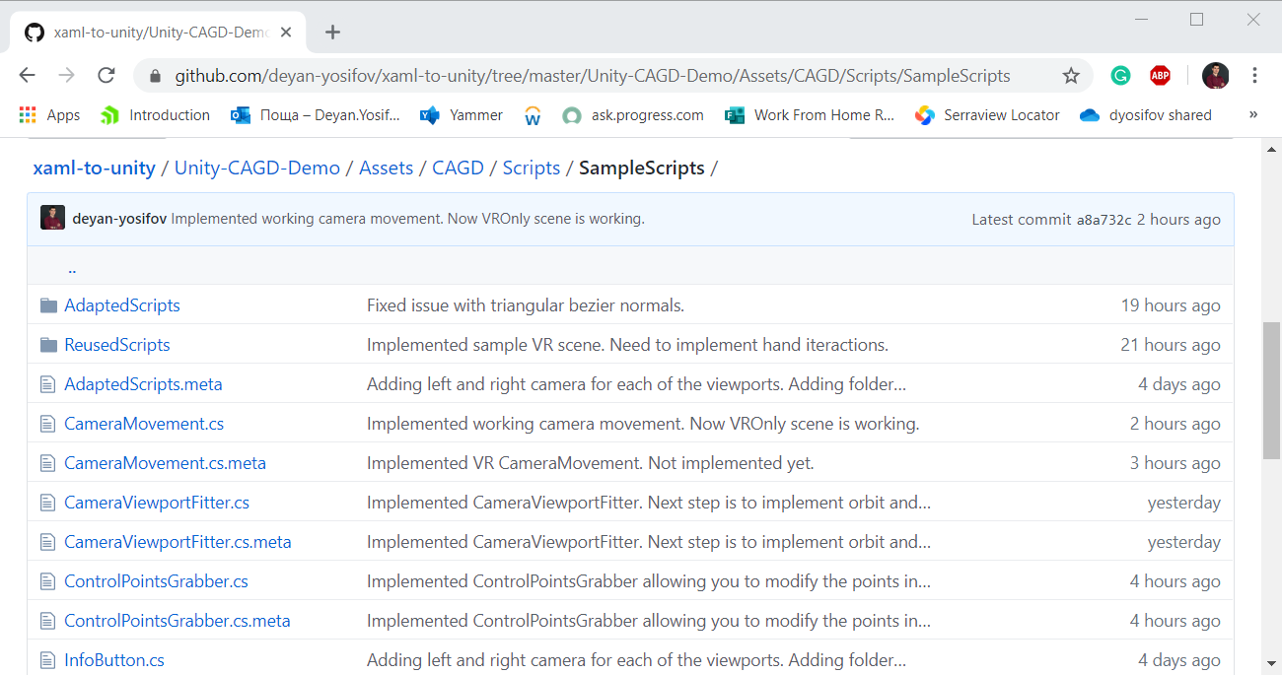
Unity scripts demo hierarchy
The Unity project contains CAGD scene which uses scripts from SampleScripts folder.
ReusedScripts subfolder contains scripts which are practically reused from the XAML demo.
AdaptedScripts subfolder has scripts which correspond to some XAML demo script but has more modification in order to adapt to Unity technology requirements.
The rest scripts are Unity specific.

Slide 11
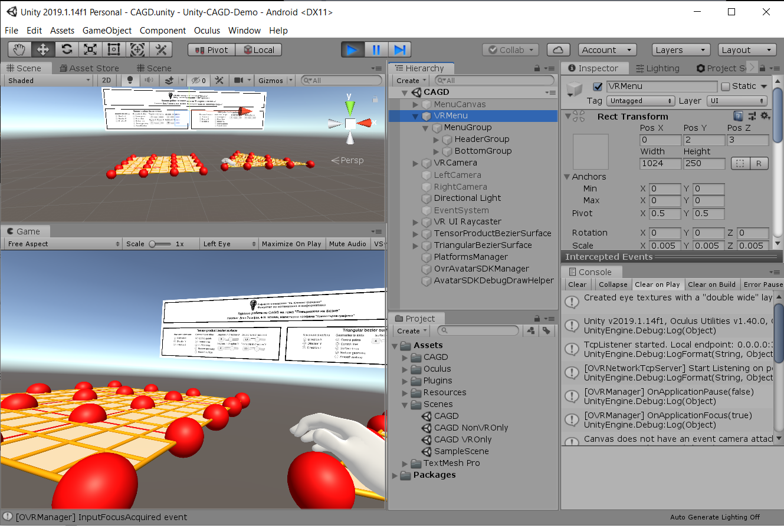
Demo time
Let’s build our demo Unity scene so that it works for Web, Mobile, Desktop and VR.
A web version of the app is already uploaded and can be seen on: http://deyan-yosifov.com/devbg/CAGD/

Slide 12

Thank you!
Контакти:
LinkedIn: https://www.linkedin.com/in/deyan-yosifov/
Github: https://github.com/deyan-yosifov
Twitter: https://twitter.com/deyan_yosifov
Следващо събитие:
Bootstrapping microservices in seconds

